Slide 1

ADBUREAU ANALYTICS PRIVATE LIMITED
Internship Assignment #1 · Machine Learning Case Study
Diabetes Readmission
Prediction
A predictive analytics and business strategy approach to flagging at-risk diabetes patients before discharge.
Prepared by: Mithil Save · Tejas Sonawne · Parth Gupta
June 2026
Adbureau Analytics — Internship Case Study

Slide 2







ROADMAP
What We'll Cover
Business Problem & Objective
Exploratory Data Analysis
Why readmissions matter, and what we're predicting
Who these patients are, and what stands out
Data Preparation
Modeling & Evaluation
Cleaning, encoding, and feature engineering
Algorithms, tuning, ensembles, and performance
Explainability
Business Insights & Recommendations
What actually drives readmission risk
Top 5 + Top 5, for hospital leadership
Business Impact & Next Steps
Where this creates value, and what comes next
Diabetes Readmission Prediction
02

Slide 3

BUSINESS CONTEXT
The Business Problem
Unplanned readmissions among diabetes patients drive up cost, strain bed and staff capacity, and often signal gaps in discharge planning rather than a single bad outcome. Hospitals rarely lack data on a patient at discharge — they lack a reliable way to turn that data into a same-day decision about who needs extra support.
OUR OBJECTIVE
Predict: readmitted
TRUE → Patient is readmitted
FALSE → Patient is not readmitted
Identify patients at risk of readmission before discharge, so hospitals can intervene early.
Our goal: build a model that flags high-risk patients before they leave the hospital — early enough for a care team to actually do something about it.
Cost Reduction
Better Outcomes
Resource Optimization
Diabetes Readmission Prediction
03

Slide 4
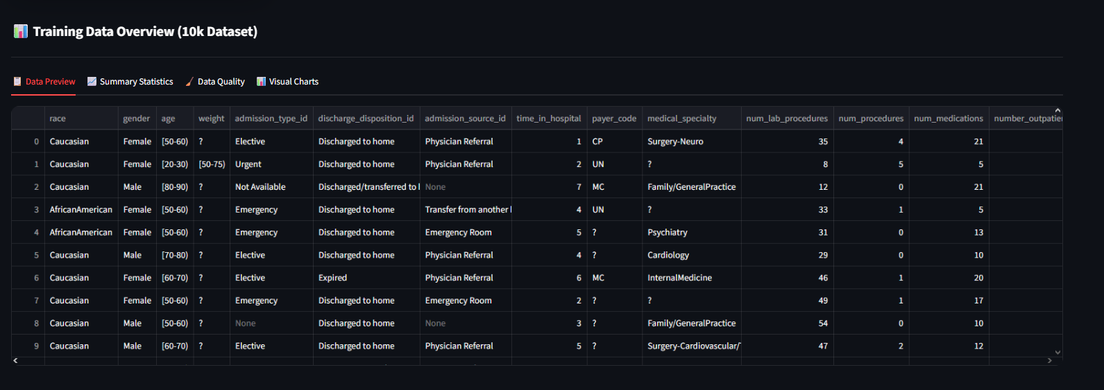
PART 1 · EXPLORATORY DATA ANALYSIS
Dataset Snapshot — 10,000 Patient Encounters
TYPICAL PATIENT PROFILE
4.4 days
15.6
avg. time in hospital
avg. medications per stay
43
7.0
avg. lab procedures
avg. diagnoses coded
Sample of raw patient records — 51 columns, scrollable in the source dashboard
Diabetes Readmission Prediction
04

Slide 5
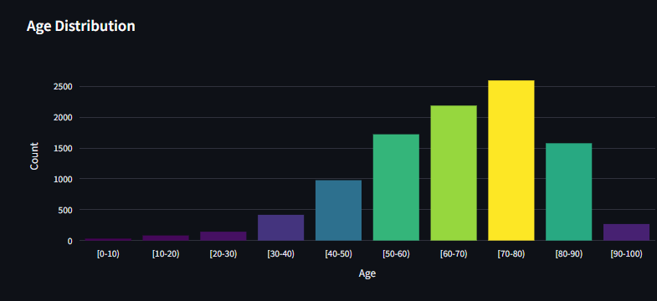
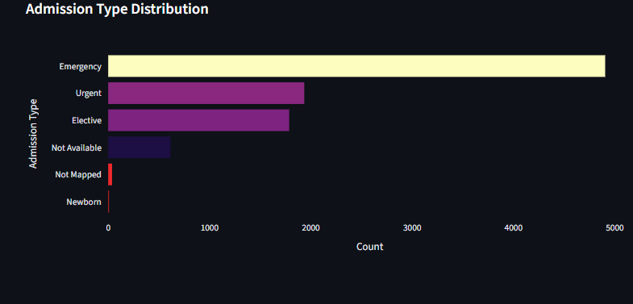
PART 1 · EXPLORATORY DATA ANALYSIS
Who Are These Patients?
Patients aged 60–80 account for the largest share of encounters
— readmission-prevention efforts will affect the most people if they prioritize this band.
Emergency admissions dominate by a wide margin
— far outnumbering Elective and Urgent combined, meaning many patients arrive unplanned, with little chance for pre-admission risk screening.
Very young (<30) and very old (90+) patients are rare here — insights for these age bands should be read with caution given the small sample size.
Diabetes Readmission Prediction
05

Slide 6
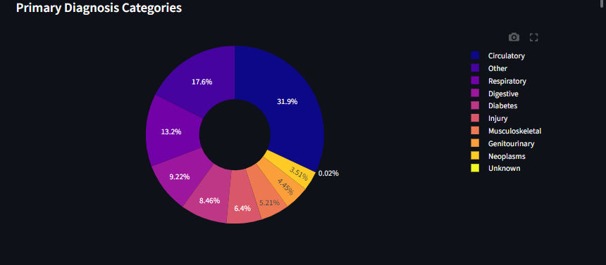
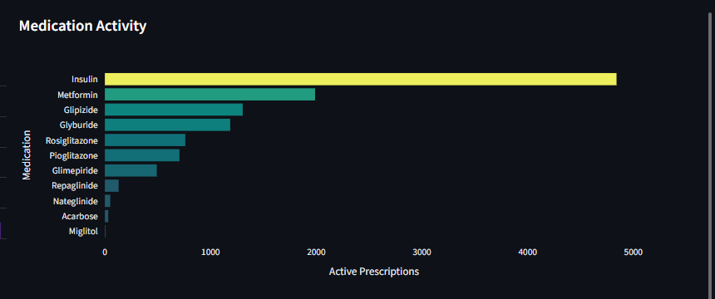
PART 1 · EXPLORATORY DATA ANALYSIS
Diagnosis & Medication Patterns
Circulatory conditions are the single largest primary-diagnosis category (31.9%)
— nearly double Respiratory (13.2%), the next-largest group. Cardiovascular comorbidity is central to this population, not just glycemic control.
Diabetes itself is the primary diagnosis in only 8.5% of encounters
— most admissions are driven by complications elsewhere in the body.
Insulin is prescribed far more than any oral agent — well ahead of Metformin, consistent with an insulin-dependent or advanced-disease population.
Diabetes Readmission Prediction
06

Slide 7
PART 1–2 · EDA & DATA PREPARATION
The Target — and Why Imbalance Matters
39.6% of patients in this dataset were readmitted — roughly 2 in 5 discharges came back.
This is a meaningfully imbalanced target. A model that always predicts “not readmitted” would already be ~60% accurate — while catching zero true readmissions. Accuracy alone is the wrong yardstick here.
We addressed this by applying SMOTE oversampling to the training set only (never the test set), and by deliberately tuning the decision threshold to favor recall over raw accuracy — more on this trade-off in Model Selection.
Diabetes Readmission Prediction
07

Slide 8

PART 2 · DATA PREPARATION
Getting the Data Model-Ready
Missing Value Strategy
Feature Engineering
‘?’ and similar placeholders treated as missing
— never as a real category.
Columns missing in over 40% of records dropped
— rather than forcing in a barely-populated field.
Remaining gaps mode-imputed, preserving the full 10,000-record sample.
age_numeric — ordinal encoding of age bands.
prior_visits — combined outpatient/ER/inpatient utilization score.
medication_changed — flags any change in diabetes meds during the stay.
ICD-9 codes → clinical categories (Circulatory, Diabetes, Respiratory, …) instead of ~700 raw codes.
A1C / glucose serum ordinally encoded to reflect clinical severity.
3.9% raw missing values → fully resolved before modeling — no nulls reach the algorithms.
Diabetes Readmission Prediction
08

Slide 9




PART 3 · CLASSIFICATION MODELING
Modeling Approach
7 Algorithms Benchmarked
3 Ensemble Strategies
XGBoost, LightGBM, CatBoost, Random Forest, Extra Trees, Gradient Boosting, Logistic Regression
Voting, Stacking, and Blending (Super Learner) combine the base models' strengths
Systematic Tuning
Imbalance-Aware Training
RandomizedSearchCV over max_depth, learning_rate, n_estimators, subsample, colsample_bytree — 5-fold stratified CV, scored on ROC-AUC
SMOTE applied to the training set only, plus decision-threshold optimization for F1 / recall
80/20 stratified train-test split used throughout
Diabetes Readmission Prediction
09

Slide 10
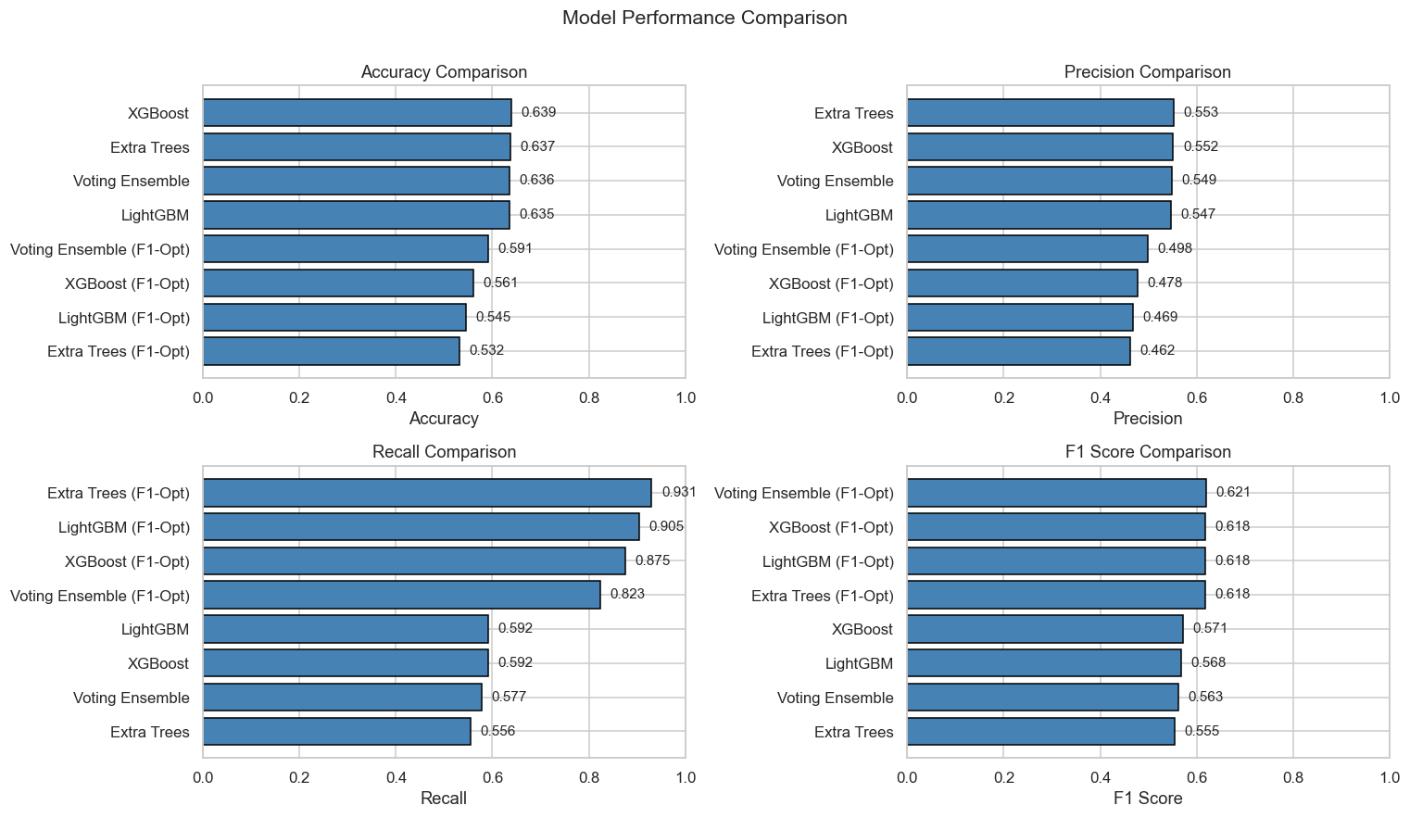
PART 4 · MODEL EVALUATION
Model Performance — Comparing the Field
Accuracy, Precision, Recall, and F1 across baseline and F1-optimized variants of each algorithm — generated directly from the evaluation pipeline.
Diabetes Readmission Prediction
10

Slide 11
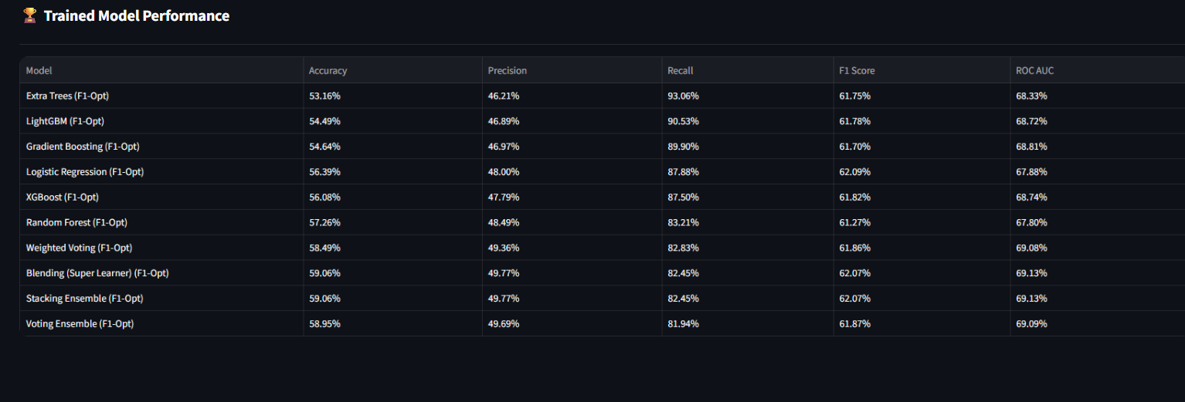
PART 4 · MODEL EVALUATION
Final Model Selection — Stacking Ensemble
59.1%
49.8%
82.5%
69.1%
Accuracy
Precision
Recall
ROC AUC
Why not the highest-accuracy model? A missed high-risk patient (false negative) costs more than an extra nurse review (false positive). The F1-optimized Stacking Ensemble trades ~5 points of accuracy for +23 points of recall vs. default-threshold XGBoost — catching 82% of true readmissions instead of 59%.
Diabetes Readmission Prediction
11

Slide 12
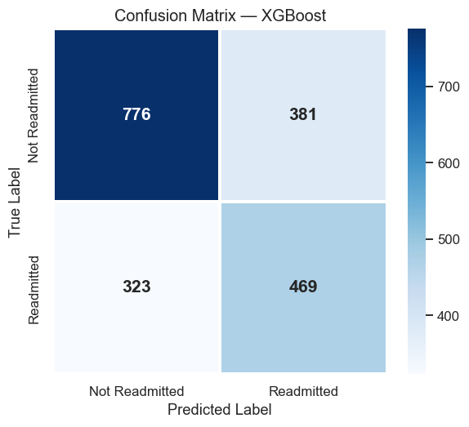
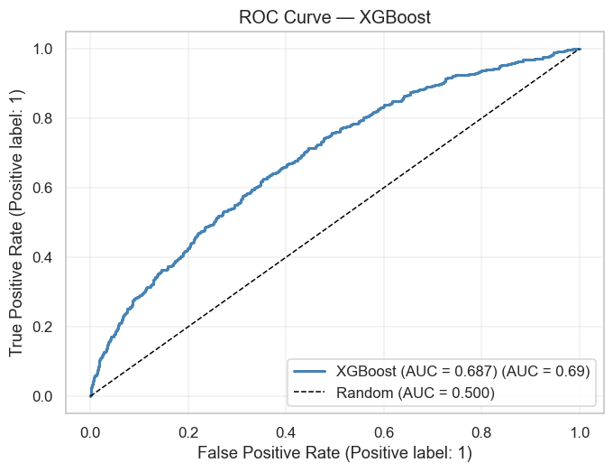
PART 4 · MODEL EVALUATION
Evaluation Deep-Dive — XGBoost (Default Threshold)
At the default 0.5 threshold, XGBoost correctly identifies 469 of 792 true readmissions (59.2% recall) and 776 of 1,157 true non-readmissions (67.1% specificity) — overall accuracy of 63.9% and ROC-AUC of 0.687. Meaningfully better than chance, with clear room to improve via richer features.
Diabetes Readmission Prediction
12

Slide 13
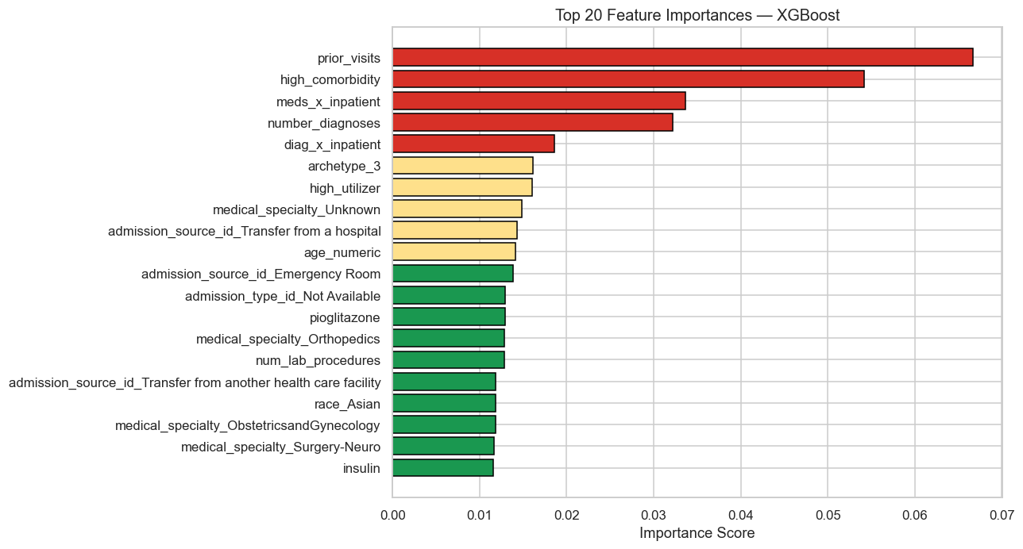
PART 5 · EXPLAINABILITY
What Actually Drives Readmission Risk
Utilization history dominates.
prior_visits and meds during a prior inpatient stay rank above any single diabetes lab value.
Comorbidity load is the #2 driver.
Multi-diagnosis patients are often readmitted for issues unrelated to glucose control.
Surprising finding:
diabetes severity itself ranks far below care-utilization history — glycemic-control programs alone may miss the bigger lever.
Practical read: the model flags “complex, high-utilization patients,” not just “poorly-controlled diabetics.”
Top-20 feature importances — XGBoost (red = strongest positive drivers of readmission risk)
Diabetes Readmission Prediction
13

Slide 14





PART 6 · BUSINESS INSIGHTS
Top 5 Business Insights
Utilization history beats diagnosis severity
Prior visits and inpatient history predict readmission better than how “sick” the diabetes itself looks.
Comorbidity load is a major risk multiplier
Multi-diagnosis patients drive a disproportionate share of all readmissions.
ER-route admissions carry elevated risk
Patients arriving without a planned admission path need closer discharge follow-up.
Readmissions are common, not rare
39.6% of this population returned — even modest model-driven targeting touches a meaningful share of discharges.
Data gaps can hide risk
Missing or unknown medical-specialty records are themselves linked to higher readmission risk — a sign of documentation gaps at admission.
Diabetes Readmission Prediction
14

Slide 15
PART 6 · BUSINESS RECOMMENDATIONS
Top 5 Recommendations for Hospital Leadership
01
Deploy as a triage flag, not a gatekeeper
Route high-risk-flagged patients to a nurse-led case review before discharge sign-off.
02
Build a structured transition-of-care track
For high-utilization patients: a 48–72 hr follow-up call plus a 7-day PCP visit.
03
Give ER-admitted patients dedicated planning attention
They show elevated risk and often lack a pre-existing care plan.
04
Close the medical-specialty documentation gap
It's both a model-accuracy issue and a care-coordination issue.
05
Favor recall over raw accuracy in production
A missed high-risk patient costs more than one extra review.
15

Slide 16
PART 6 · BUSINESS IMPACT
Business Impact & Next Steps
~1.3x
82%
~40%, not 100%
risk concentration
catch rate
of discharges need priority outreach
Flagged patients readmit at 49.8%, vs. a 39.6% population base rate.
Share of true readmissions identified at the recall-optimized threshold.
Targeting flagged patients beats blanket follow-up for every discharge.
NEXT STEPS
Richer clinical features
— lab-result trends and social-determinant signals.
Probability calibration
— so risk scores translate cleanly into care-team action.
Discharge-workflow integration
— surfacing the flag where nurses already work.
Bonus: a RAG-based clinician assistant answering “why was this patient flagged?” in plain language.
Thank you
Mithil Save · Adbureau Analytics Internship

